Slide 1
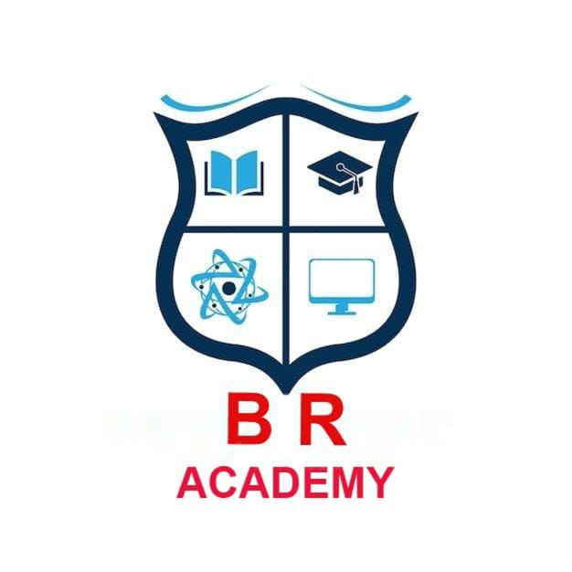
Speech to Sign Language Conversion
An overview of technologies, challenges, and innovations that bridge communication between hearing and speech-impaired communities.

Slide 2
Introduction
Speech to sign language conversion is an assistive technology that translates spoken words into corresponding sign language gestures using AI, computer vision, and natural language processing.

Slide 3
Need for Conversion Systems
• Communication barriers exist between hearing individuals and the deaf community.
• Manual interpreters are not always available.
• Technology offers real-time and scalable solutions for inclusivity.

Slide 4
Sign Language Basics
Sign languages are visual-manual languages using hand gestures, facial expressions, and body posture. Examples include American Sign Language (ASL), British Sign Language (BSL), and Indian Sign Language (ISL).

Slide 5
System Architecture
Typical system components include:
1. Speech Recognition Module
2. Natural Language Processing Unit
3. Gesture Generation and Animation Engine
4. Output Visualization Interface

Slide 6
Speech Recognition
Uses deep learning models such as CNNs and RNNs to convert spoken input into text. Tools include Google Speech API, CMU Sphinx, and DeepSpeech.

Slide 7
Natural Language Processing (NLP)
NLP interprets grammatical structures and semantics of recognized text to identify meaningful sign language equivalents.

Slide 8
Sign Language Generation
Sign generation can be achieved using:
• Animated avatars performing gestures.
• 3D motion capture data.
• Pre-recorded sign video databases.

Slide 9
Gesture Representation Models
Gestures are represented as skeletal joint coordinates or motion vectors. Machine learning models predict hand configurations and movements.

Slide 10
AI and Machine Learning Role
AI algorithms learn mapping from text or speech to gesture sequences. Neural networks such as LSTMs, Transformers, and GANs are commonly applied.

Slide 11
Hardware Components
• Microphone for speech input.
• Computer or smartphone for processing.
• Display or avatar rendering screen for sign output.

Slide 12
Software Frameworks
• TensorFlow and PyTorch for model training.
• Unity and Blender for 3D animation.
• Python and MATLAB for prototype development.

Slide 13
Challenges
• Lack of universal sign language standardization.
• Complexity in emotion and tone representation.
• High computational cost for real-time animation.

Slide 14
Recent Advances
• Real-time mobile applications using edge AI.
• 3D sign avatars with realistic hand articulation.
• Integration of multilingual speech recognition.

Slide 15
Applications
• Education tools for deaf learners.
• TV broadcast and video captioning.
• Public service kiosks and healthcare communication.

Slide 16
Case Studies
Projects like 'SignAll' and 'KinTrans' demonstrate commercial feasibility using AI-driven sign translation in real-world environments.

Slide 17
Ethical Considerations
• Respect for linguistic diversity in sign languages.
• Data privacy in speech collection.
• Avoiding bias in gesture recognition datasets.

Slide 18
Future Scope
• Integration with AR/VR for immersive experiences.
• Bi-directional conversion (sign to speech).
• Global standardization for digital sign lexicons.

Slide 19
Conclusion
Speech to sign language conversion technology has the potential to make communication inclusive, empowering millions with hearing impairments.

Slide 20
References
1. IEEE Transactions on Human-Machine Systems
2. Journal of Assistive Technologies
3. SignAll, KinTrans, and Google AI Research Papers

